Slide 1

Group 4 Final Project
League of Legends Network Analysis
Team Member:
Shikuan Gao
Ruiwen Shi

Slide 2
Background
League of Legends (LoL) is a multiplayer online battle video game developed and published by Riot Games in 2009.
The Rise of E-Sports Industry
Started with fans organizing tournaments
Riot grafted the LoL Season One Championship in 2011
Brought in $1.5 billion total revenue in 2017, could hit $2.3 billion by 2022
LoL Officially becomes the most popular E-Sport in 10 years
Most played PC game in the world
Professional league in many regions such as North America, Europe, Korea and China
World Champion Series once a year

Slide 3
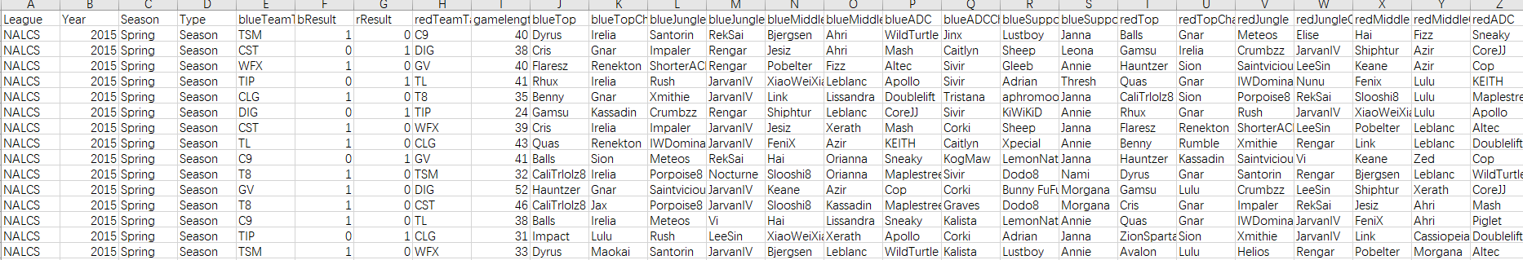
Data Source
2015-2017 matchinfo from Kaggle
Over 7000 matches information including all the features needed (result, champion selected, game length)

Slide 4
Objective
Exploratory Data Analysis (EDA) of one feature Game length
Analyze highest select rate champions for last 3 years (2015-2017)
Generate a visual network for league of legends for season 2017
Powerful teams (Win Rates & Win Counts)
Game style of teams (Average Game length)
Special team (Betweenness)

Slide 5
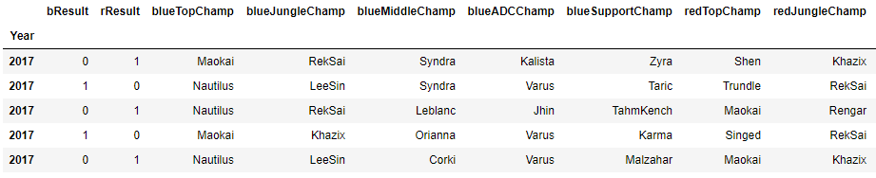
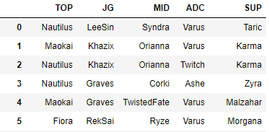
Data Cleaning
1.Get all matches information from 2017
2.Get the winning side champions selected

Slide 6
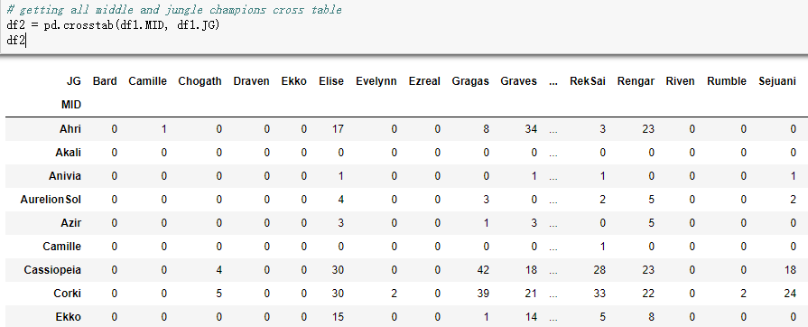
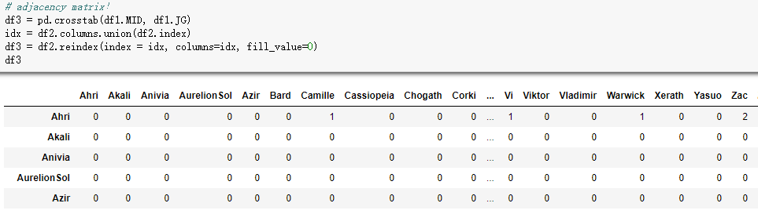
Data Cleaning
3.Get all middle and jungle champions cross table
4.Create adjacency matrix

Slide 7
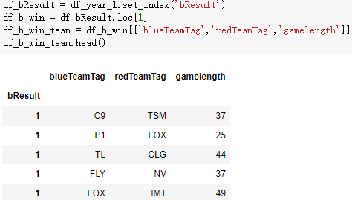
Data Cleaning
5.Get game length infos for each matches from winning team directed to losing team

Slide 8
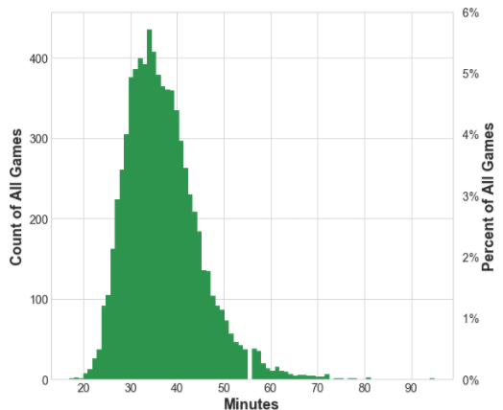
EDA of Game Length
Histogram
Shows the most frequent minute value of all the games played.
Traditional count of all games is on the left y axis
Percentage of all games is on the right y axis.
Skewed right
Outlier game lengths around the 60 minute mark.

Slide 9
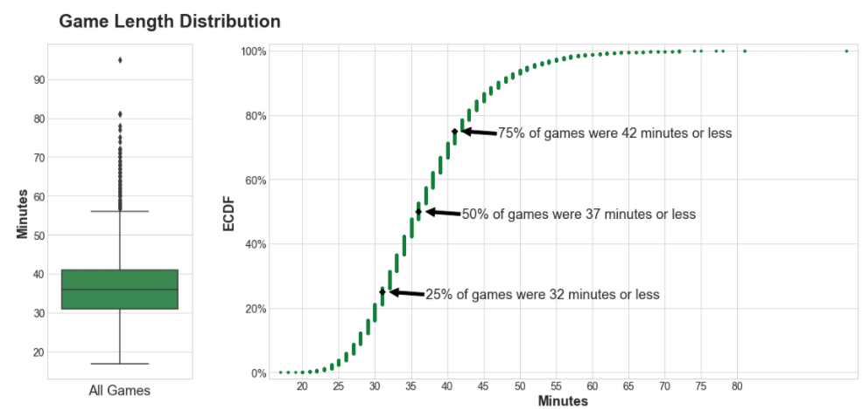
EDA of Game Length
Box plot
IQR (Interquartile range）
Each horizontal line of the box represents the 25th, 50th, and 75th percentiles
ECDF (Empirical Cumulative Distribution Function)
To analyze what percent of the variable data is at or below a particular value.

Slide 10
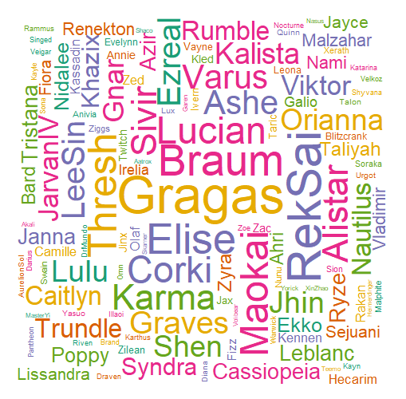
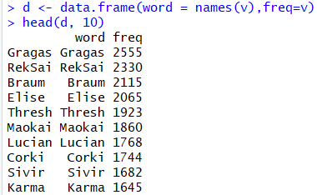
Data Visualization
Word Cloud for most selected champion for last three years

Slide 11
Data Visualization - NetWork
Establishments
Nodes - Each Teams
Edges - Matches (directed: source - win team, target - lost team)
Weight - Game Length
Degree - The counts of matches that one team had played
Weighted Degree - Total Game length of each team
Win Rate = Out-Degree/Degree (attribute created)
Average Game Length = Weighted Degree/Degree (attribute created)
Allow multiple edges between two nodes, as teams could play against each other repeatedly

Slide 12
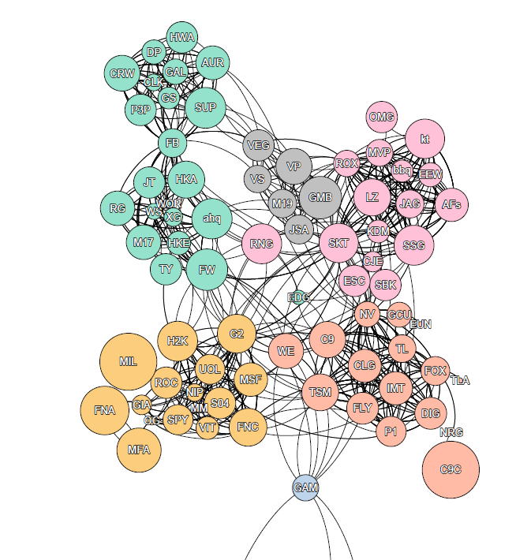
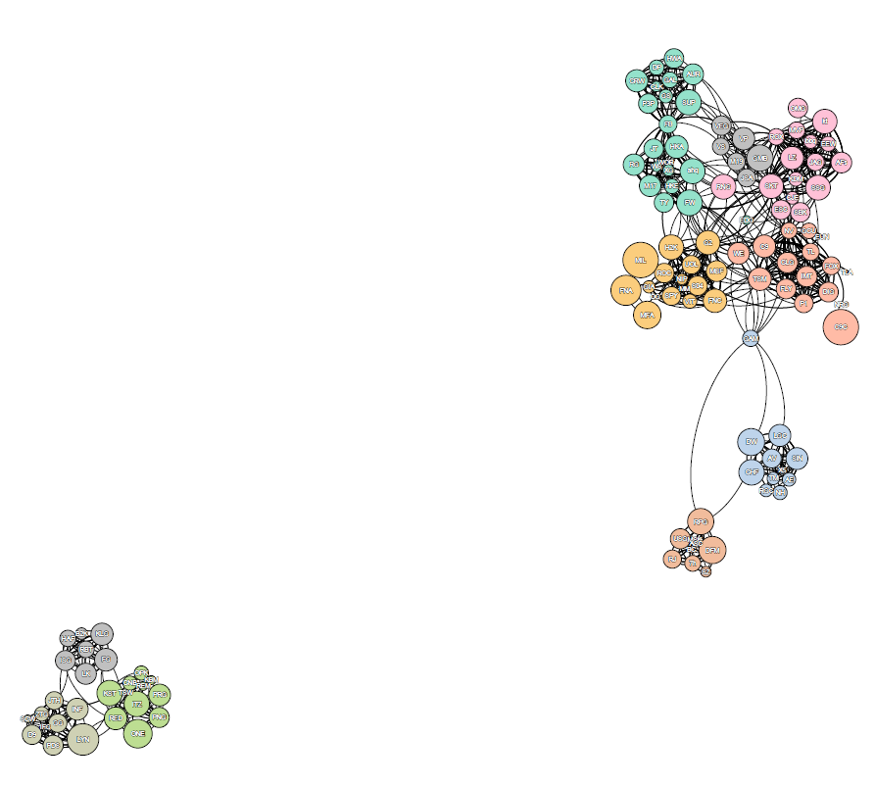
Data Visualization - NetWork
Nodes color: modularity
Nodes size: win rate

Slide 13
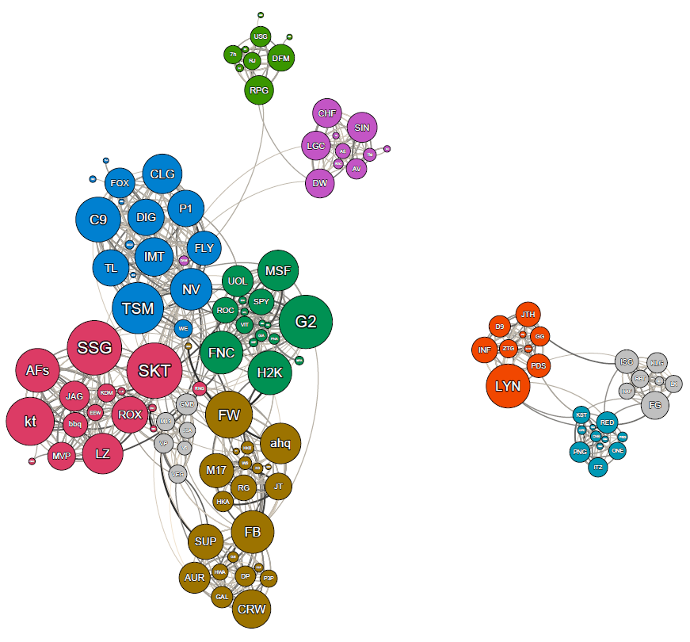
Data Visualization - NetWork
Node color: modularity
Node size: out-degree(win counts)

Slide 14
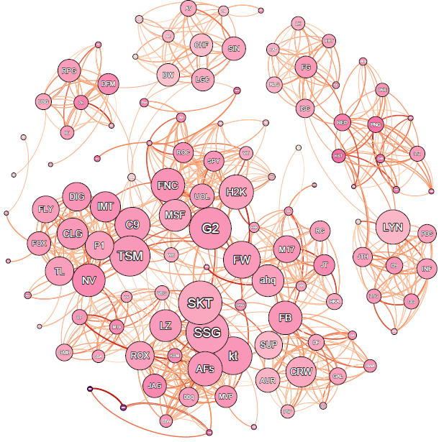
Data Visualization - NetWork
Node color: average game length
Node size: out-degree(win counts)
Edge color: weight

Slide 15
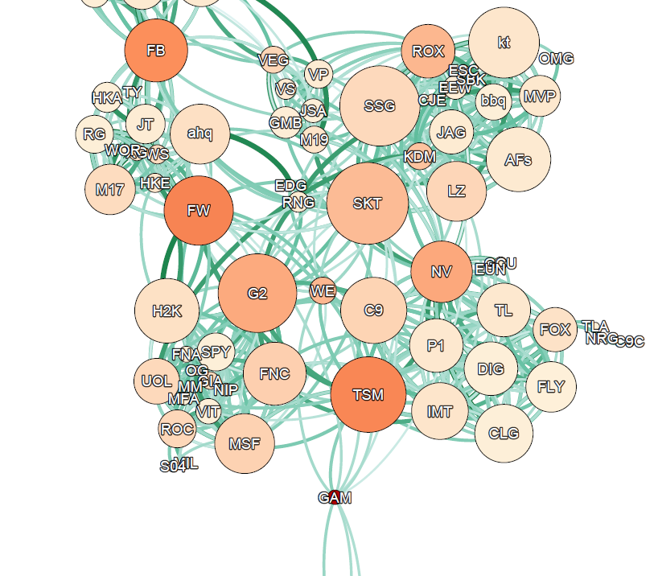
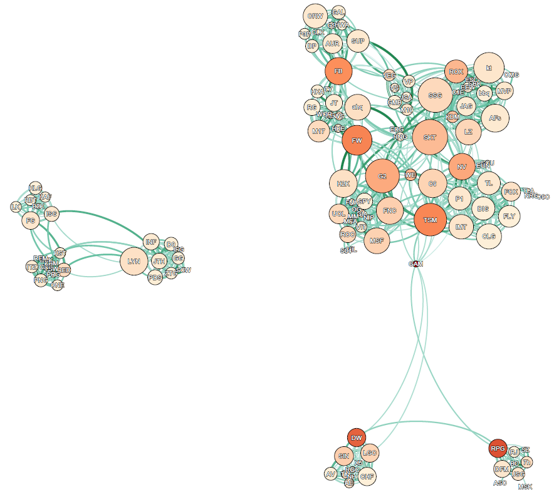
Data Visualization - NetWork
Node color: betweenness centrality
Node size: out-degree(win counts)
Edge color: weight

Slide 16

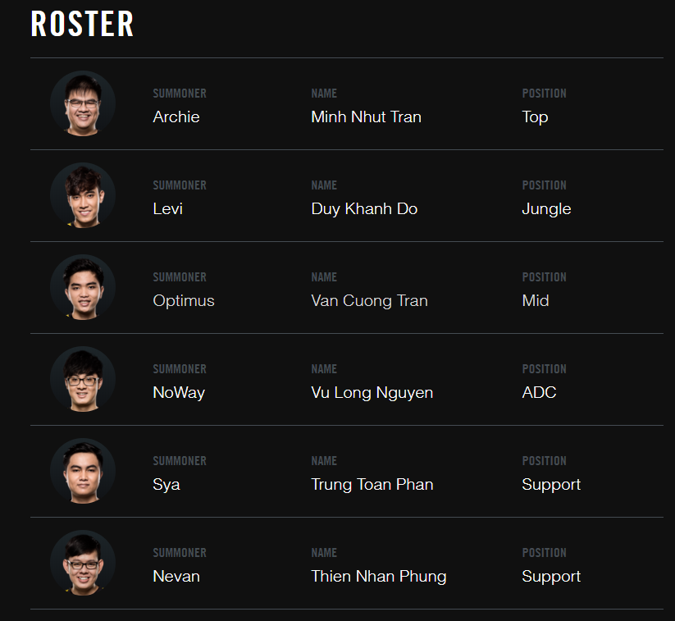
Data Visualization - Exception
The GIGABYTE Marines surprised everyone at the 2017 Mid-Season Invitational when they not only survived the Play-In, but thrived in the Group Stage, taking wins off some of the biggest teams in the world. They earned the GPL a Group Stage seed at Worlds, and were the rightful ones to take it as they reclaimed the title of GPL Champions with their victory over Thailand’s Ascension Gaming. Their hyper aggressive playstyle will make them one of the most exciting teams to watch at Worlds 2017.

Slide 17
Conclusion
Win counts performs better than win rate when illustrating the power of a team.
No significant difference founded in average game length among most teams. Most matches ended between 30 - 40 mins.
Betweenness centrality shows powerful teams within each module, as they would be directly invited to represent their own division.
However, GAM is an exception, marked by betweenness, as the intermediary between secondary league and major league.

